Slide 1
Sai Phyo Lwin Oo Secretary Agribusiness Development Committee Southern Shan State Chamber of Commerce and Industry
A Business Perspective on Investing in Shan State

Slide 2
Vision
“Economic vitality through a relevant and proactive agribusiness community “
Mission
“To promote agribusiness community while striving to improve the overall quality of life in our community”

Slide 3
Key Challenges for Agribusiness Development
Lack of collaboration in national and regional level strategic planning
Low capacity in businesses to get a competitiveness
Insufficient Database and Research
No well functioning farmer cooperative
Lack of value chain financing
Poor Infrastructure
Lack of human capital development and workforce planning

Slide 4
Myanmar Sustainable Development Plan (2018-2030)
National Level Initiatives
Myanmar Investment Promotion Plan (2016 – 2035)
Myanmar Agriculture Development Strategy and Investment Plan (2018 – 2023)
National Export Strategy (2019 – 2024)
Myanmar Digital Economy Roadmap (2020– 2025)
Regional Level Initiatives
Shan State Investment Committee (SSIC)
We, SSSCCI are now collaborating under SSIC for
Improving investor, business support system and services,
Developing local business and industries,
Enhancing investment promotion, locational marketing and branding.

Slide 5
Inviting Partners for Agribusiness Development
Research
Agri-economics Research with Center for Economic and Social Development (CESD)
Agricultural Research with Shan State Agricultural Research Center (SSRC), Aungban
Business Coaching Program
Investor Readiness Program together with One to Watch to accelerate existing agribusiness

Slide 6
Prioritizing Quick-Win Crops
Focusing on value chain development of prioritized crops is important
to enhancing State economy within the limited resources.
Corn
Oilseed Crops
Mango
Avocado
Ginger
Garlic
Tea
Rice
Tomato
Potato
Coffee
Vegetables
Beef Cattle
Looking for the Champions who are dedicated in each specific crops to collaborate
on different supportive resources to be a successful business model in the region.

Slide 7
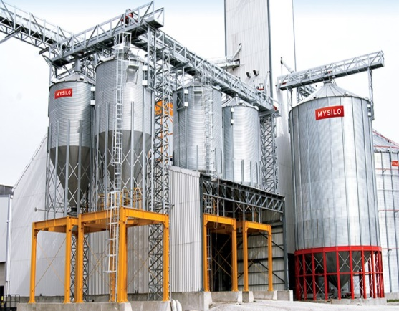
Corn Vision 2020
As an pilot project, we are now dedicating corn value chain development using Internet Communication Technology to get a competitive advantage on regional level corn production.
Creating a system to reach maximum production efficiency and access to market stability
Implementing smart farming technology
Get into Grain Dryer &
Silo System
Access to local and
Regional trade agreement
It is not only on corn, the system can be develop but also on other crop production system.

Slide 8
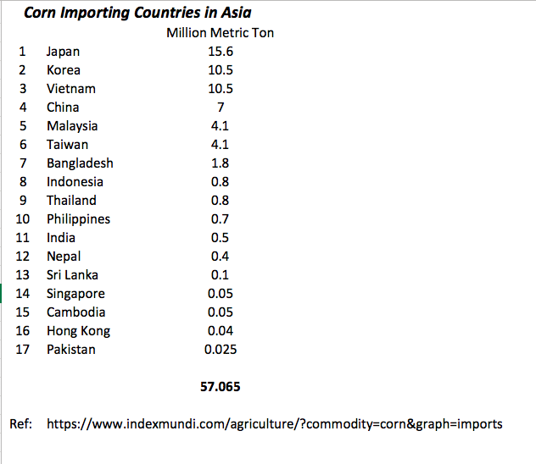
Why on Corn?
Domestic Demand
Asia Region Demand
Myanmar Corn Production 2017-18 is 2.5 MMT
50% of annual corn production is exported
98% of exports go to China via border trade
50% Production is from Shan State
40% of annual corn production goes to domestic use
Estimated domestic corn demand will be 3 MMT in 2023
Estimated total feed production capacity of the top 12 Feed Mills in Myanmar is 100,000 tons per month
Ref: Myanmar Corn Value Chain, Mekong Business Initiative
USDA foreign agriculture grain report

Slide 9
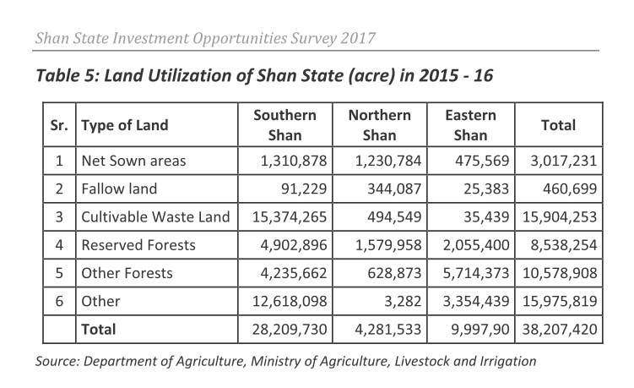
$ Billion Trade Business Opportunities
Crop Rotation is important in corn production.
After corn harvesting, growing edible oil seeds crop such as sunflower, soybean, niger etc. is not only increase income to the farmers but also enhance the soil fertility.
Myanmar edible oil imports total about 800,000 tons a year, most of which is palm oil, and 500,000 tons of livestock feed is imported annually.
Corn Vision 2020 aims to develop 1 million acres in Southern Shan State to create $ Billion Trade Business Opportunities and it can support the State infrastructure needs.
Ref: Myanmar Edible Oil Millers Association

Slide 10
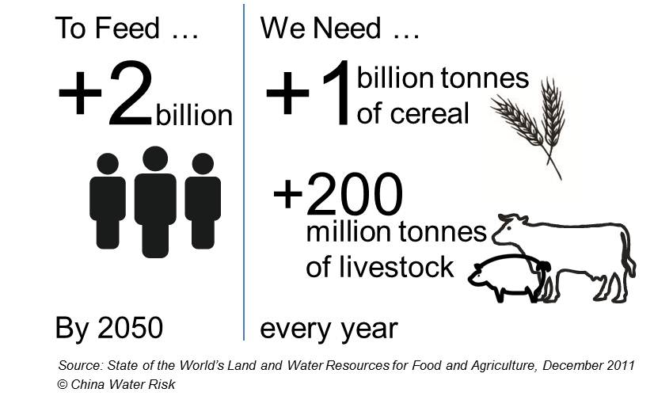
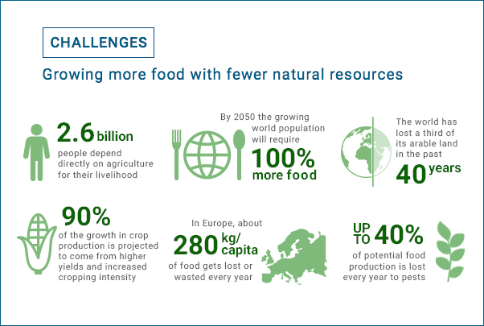
Investment Opportunities
Huge Area of Land with different agro-ecological zones
Can produce variety of nutritious foods for the world in 2050

Slide 11
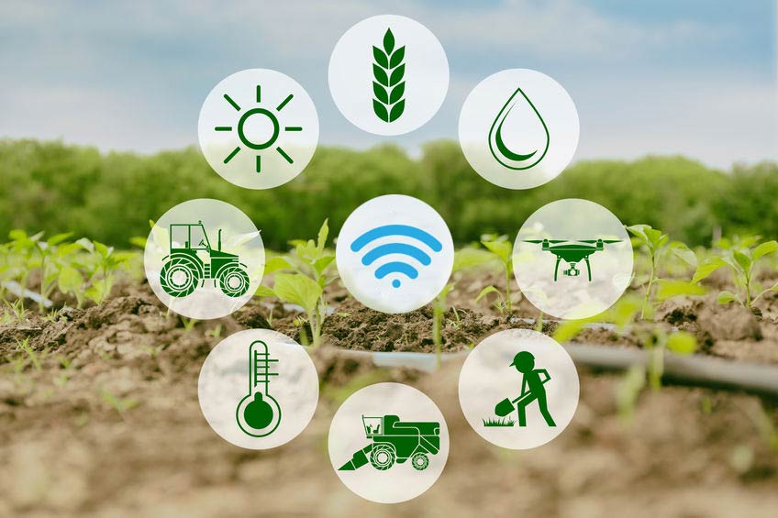
Internet Communication Technology in Agriculture
Internet of Things (IoT) technology is expected to play a significant role in enhancing agricultural productivity to meet food demand.
Smart agriculture incorporates IoT-based advanced technologies and solutions to improve operational efficiency, maximize yield and minimize wastage through real-time field data collection, data analysis, and deployment of control mechanism.

Slide 12
AgriTech Hackathon 2020, Taunggyi
Creating Agricultural Tech Ecosystem with Young Generation is crucial for the success of Myanmar Agriculture Sector
We would like to invite to support and participate in that event.

Slide 14
Thank You for your attention!
Mobile: +95941002828
Email: saiphyolwinoo@aegagriculture.com

